Slide 1
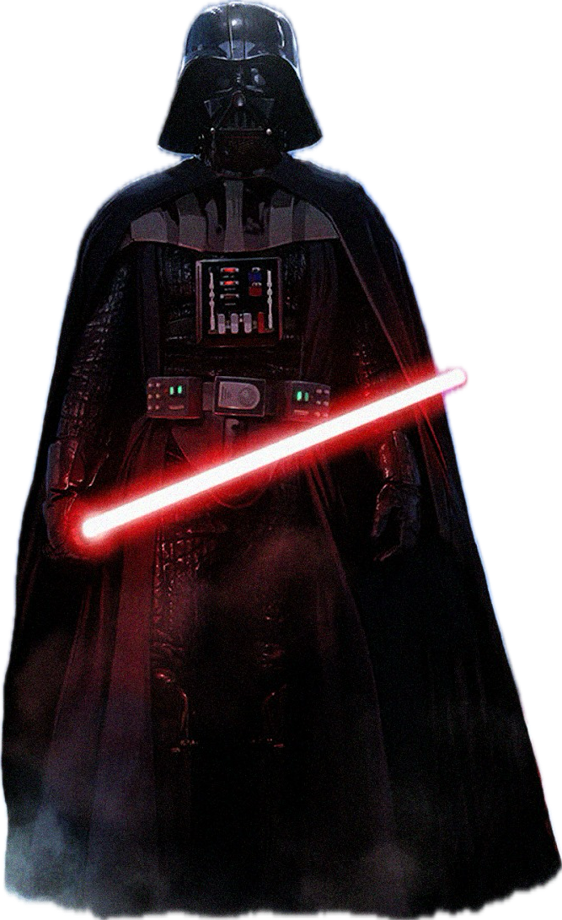


TEJUS DINESH
ANIRUDH BM
SRIHARSHA P
MANIKANTAN S

Slide 2
Whisper to Anakin – some that push him towards darkness, others that keep him in the light just enough to preserve his life. With each enemy he defeats, the lure of the dark side grows, but so does the risk to his life. Beware - if Anakin's urge for darkness grows too strong, he will throw caution to the wind, leading to his destruction.

Slide 3
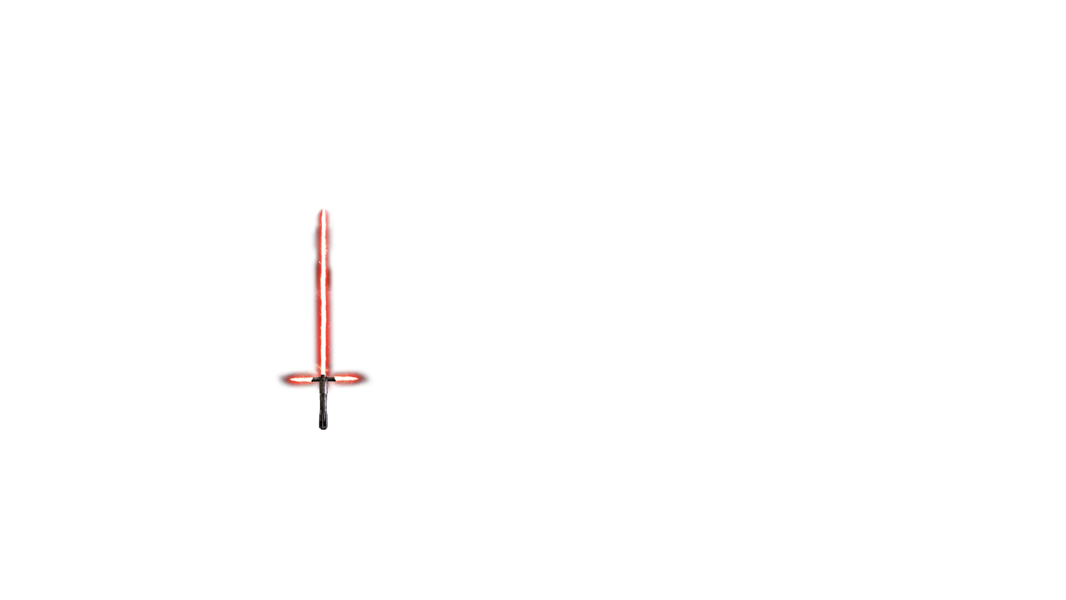
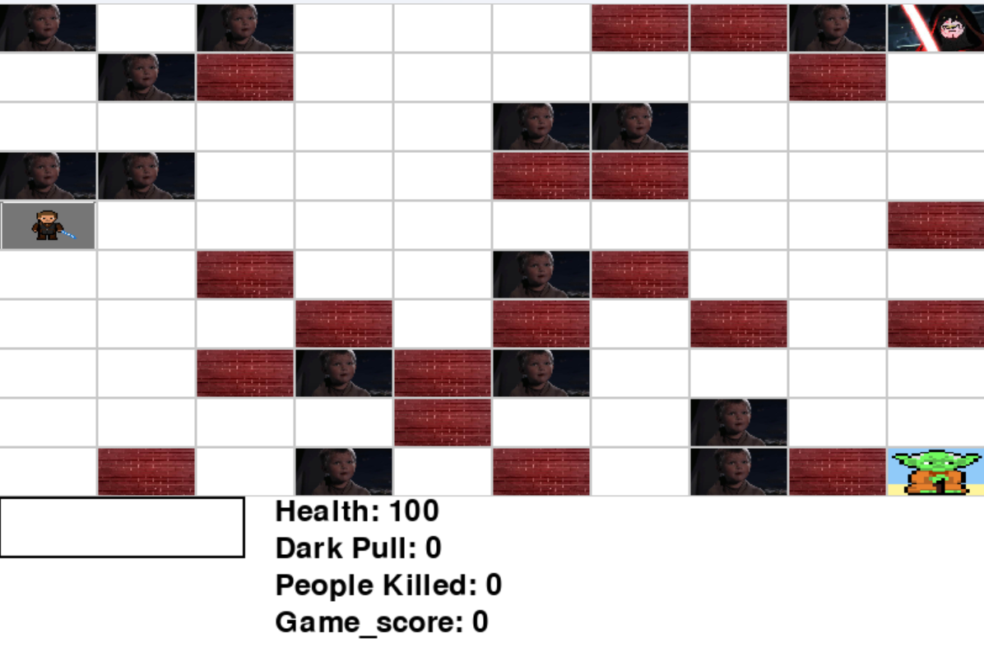
THE GAME!

Slide 4
ENVIRONMENT
Agent Parameters:
Health
Dark Pull
Trust
User Action Space:
Assertion Statements
Agent Action Space:
Up
Down
Right
left
Notes:
Action Space
State Space
Maze generation
-> Constraints
-> Search Algos
Agents Parameters
Intro Concepts of Model – Tech

Slide 5
ENVIRONMENT – GRID GENERATION
Initialise empty grid
Set youngling on the maze
Set Goal States & Start state
& Obstacles
Let’s Play
Check Path to Goal

Slide 6
REWARDS
Items | Initial Rewards
Kill | -50
Light Goal | 50
Dark Goal | -50
Empty Cell | -1
Obstacles | -inf
Notes:
Custom Function

Slide 7






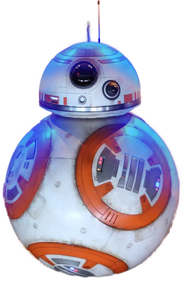
How it Works!
NLP
Sentiment Analysis
Modify Dark Pull
Anakin takes
action
User input
Example -
You should eat dirt!
-0.638
 |  | Dark
Enemy | Anakin
### | Enemy | ###
65
Dark pull
90

Slide 8
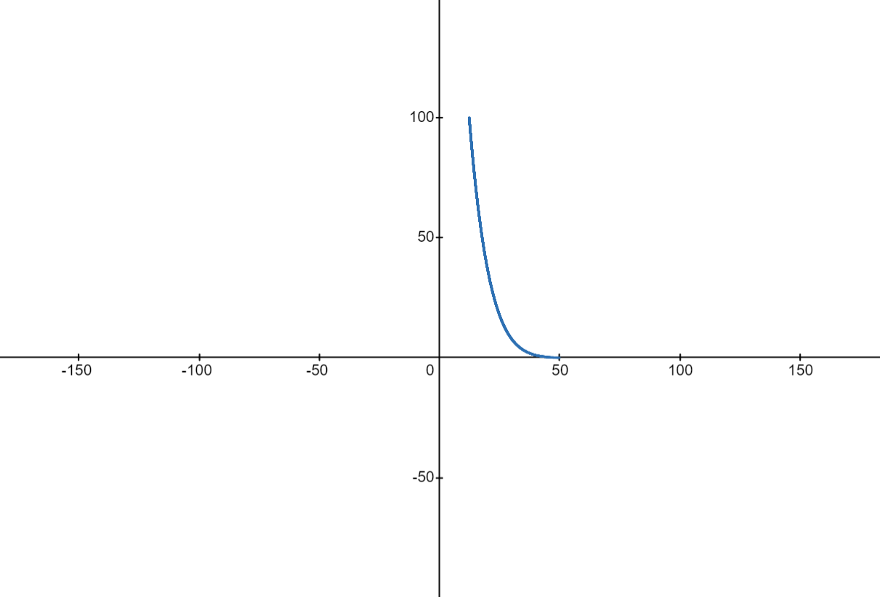
TAMH Function
Killing Reward
Compassion
Reward

Slide 9
TAMH Function
Killing Reward
Compassion
Reward

Slide 10
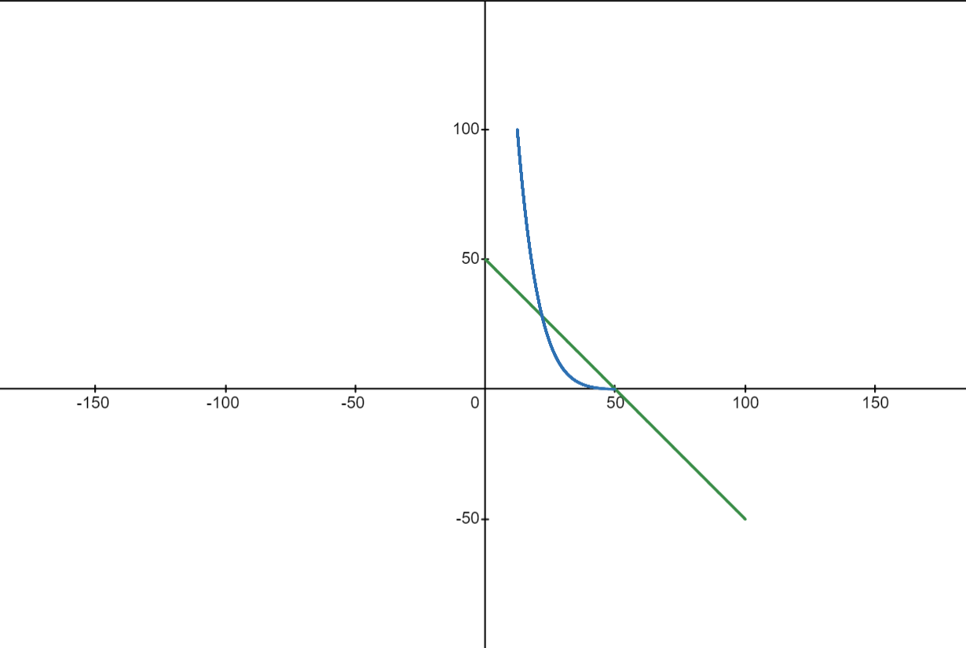
TAMH Function
Killing Reward
Dark Goal Reward
Compassion
Reward

Slide 11
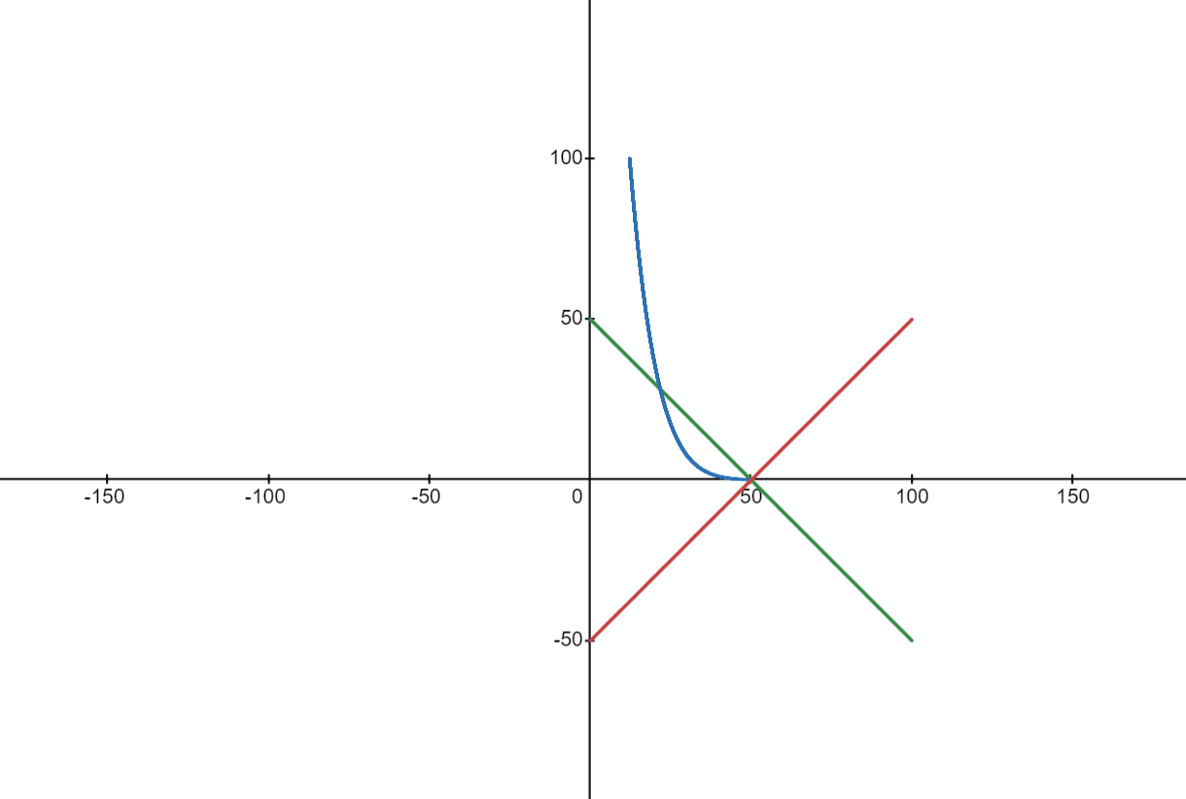
TAMH Function
Killing Reward
Dark Goal Reward
Light Goal Reward
Compassion
Reward

Slide 12
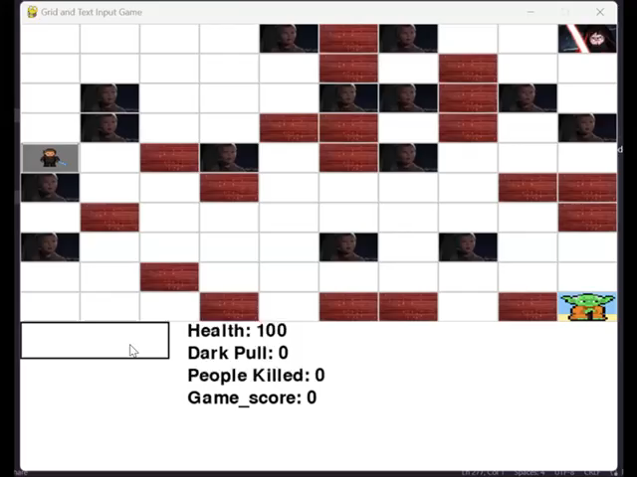
Let’s Play!

Slide 13
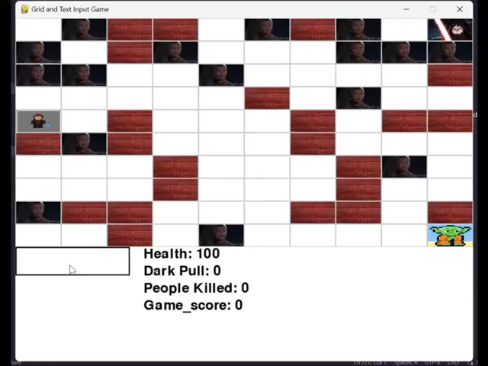
Let’s Play!

Slide 14
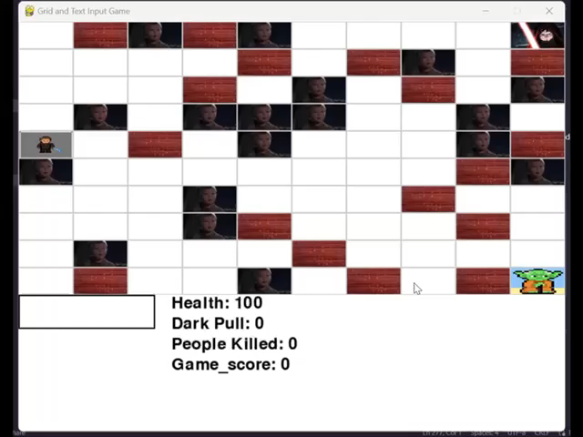
Let’s Play!

Slide 15
Thank You!
This game was solely made for the purpose of entertainment
PS: Groups reviewing us – Coffee on us ☺

